Slide 1
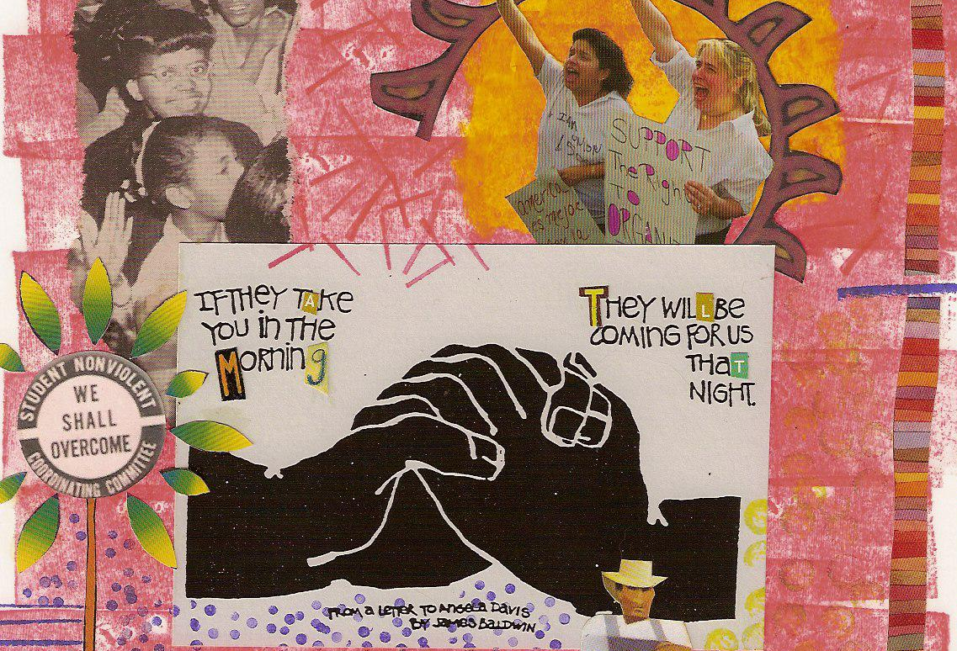
RACISM 101

Slide 2
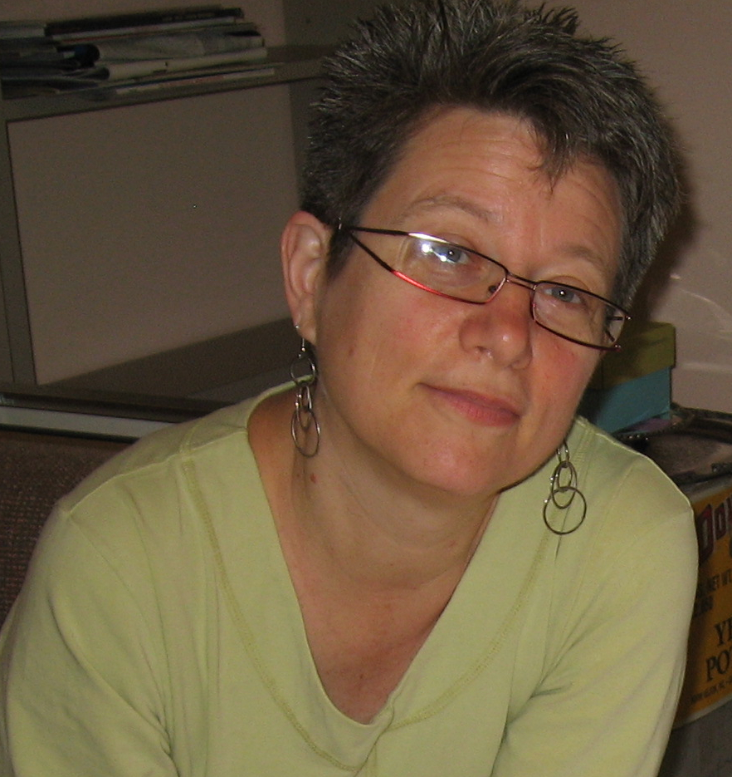

Slide 2

Slide 3
Slide 3
1. Shared Language
2. Shared Framework
3. Know Our History
4. Take Action

Slide 4
Slide 4
How do you define racism?

Slide 5
Slide 5
RACISM =
Race Prejudice +
Social & Institutional Power

Slide 6
Slide 6
RACISM =
Race Prejudice +
Social & Institutional Power
A System of Advantage Based
on Race

Slide 7
Slide 7
RACISM =
Race Prejudice +
Social & Institutional Power
A System of Advantage Based
on Race
A System of Oppression Based
on Race

Slide 8
Slide 8
RACISM =
Race Prejudice +
Social & Institutional Power
A System of Advantage Based
on Race
A System of Oppression Based
on Race
A White Supremacy System

Slide 9
Slide 9
Now I want you to talk with each other about these definitions and let me know if you have any comments or questions.

Slide 10
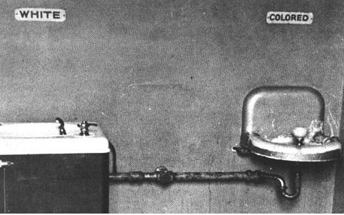
Race is not biologically real.
Race was constructed for
political and cultural (social) purposes.

Slide 11
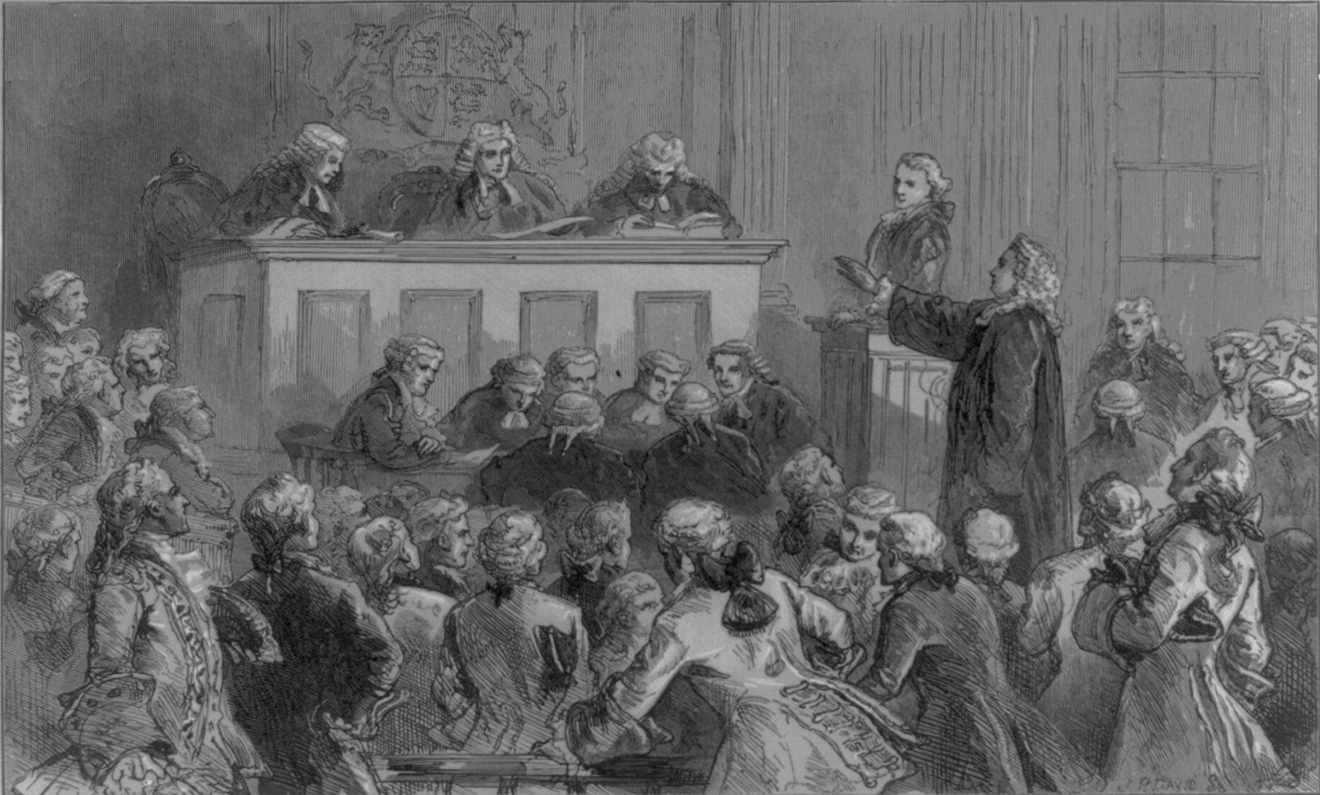
Slide 11
Notes:
As early as 1640, however, before the word "white" ever appeared in colonial law, the colonial courts began to make racialized distinctions that set up white privilege.

Slide 12
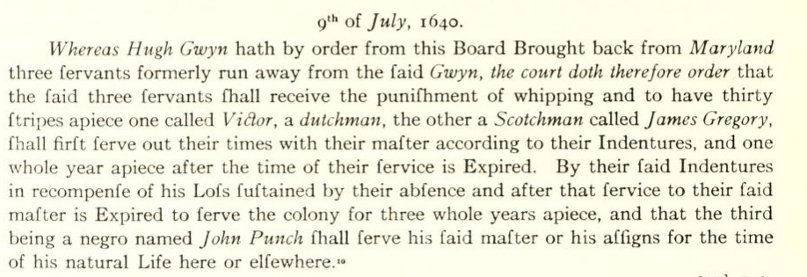
Slide 12
Notes:
One of the earliest examples of the establishment of white privilege involves three servants working for a farmer named Hugh Gwyn; the three servants attempted to run away to Maryland. In the records from the case, one was described as a Dutchman, the other a Scotchman; the third was described as a Negro. They were captured in Maryland and returned to Jamestown, where the court sentenced all three to 30 lashes -- a severe punishment even by the standards of that time. The Dutchman and the Scotchman were sentenced to an additional four years of servitude. The black man, named John Punch, was ordered to "serve his said master or his assigns for the time of his natural Life here or elsewhere."

Slide 13
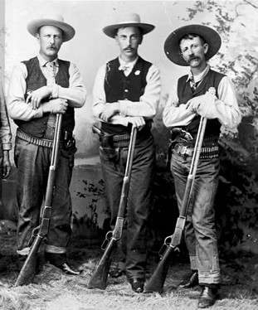
Slide 13
Notes:
By the 1730s, legal and social racial divisions were firmly in place. Historian Edmund Morgan wrote: “Only one fear was greater than the fear of black rebellion in the new American colonies. That was the fear that discontented whites would join black slaves to overthrow the existing order.” The landowning elite constructed race and whiteness as a tool of control, persuading poor and working class European immigrants to give up their language and customs, assimilate into whiteness, and ignore their economic and social common ground with peoples brought from Africa into slavery and Indigenous peoples being forced off their land. Most Black people brought forcibly from Africa and their descendants were enslaved and even free Black people had no right to vote, bear arms or bear witness in court. Black people were also barred from participating in many trades during this period. During this period, colonial governments regularly made and broke treaties with Indigenous peoples, taking land and pushing whole nations of people westward; our current government continues this process. Meanwhile, immigrants from Europe, who would merge over time into whiteness, gained the right to corn, money, a gun, clothing and 50 acres of land at the end of their indentureship. Often "free" white men found paid work in the capture and control of runaways and Indigenous peoples. Slave patrols and Night Watches were designed to monitor the behavior of enslaved and Indigenous people; in fact these patrols were the origin of our modern police departments. In other words, poor whites “gained legal, political, emotional, social, and financial status ... directly related to the ... degradation of the Indigenous and the enslaved.

Slide 14
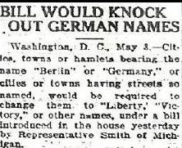
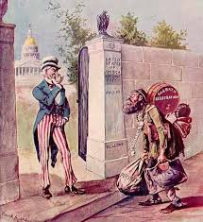

Slide 14
Notes:
Rather than talk explicitly about this, we offer the popular narrative that we are a nation of immigrants. We neglect to mention the ways in which many immigrant groups from Europe were initially despised although always granted eventual access to citizenship. The American dream, we are told, is a story of people who come to the United States, work hard, and become successful; left unsaid is how success is meant only for those who can and do merge into whiteness, only meant for immigrants from Europe.

Slide 15
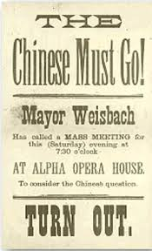
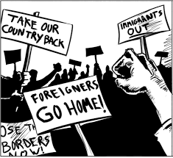
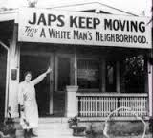
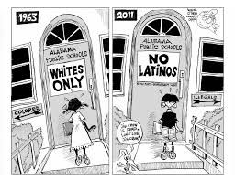
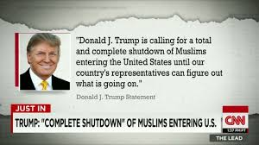
Slide 15
Notes:
The line in the sand has always been and is still race; immigrants of color, immigrants from south of our border, from the Middle East, from India, from Japan and China have never been invited into citizenship in the same way as their European counterparts. The history of the U.S. is a history of excluding and exploiting immigrant people and communities of color while also blaming and castigating them for being the racialized, “dangerous” other.

Slide 16





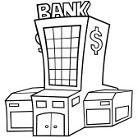


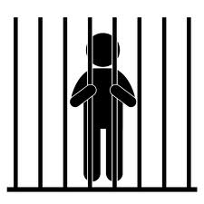
Slide 16
. . . .
Notes:
An in depth look at our nation’s history will show that every institution in the U.S. participated in constructing race and racial categories.

Slide 17
Slide 17
WHITE
east indian
japanese
chinese
latinx
chicano
arab
indigenous
black

Slide 18
Slide 18
We just covered a lot of history in a few slides. Take about 3 minutes to talk with each other about what strikes you and I’ll check in with you when you’re done.

Slide 19
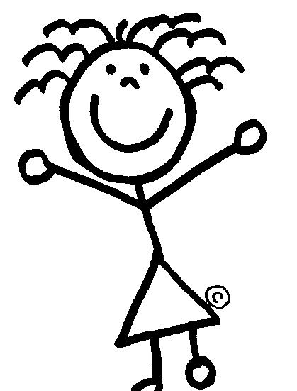
Slide 19
3 Expressions of Racism
personal
institutional
cultural

Slide 20
Slide 20
policies
procedures
practices
INSTITUTIONAL

Slide 21
Slide 21
INSTITUTIONS create
policies and procedures and
practices that
INCLUDE
EXCLUDE
SERVE
UNDERSERVE
FINANCE
EXPLOIT
SUPPORT
white people
OPPRESS
People of Color
INSTITUTIONAL RACISM

Slide 22
Slide 22
SMALL GROUP DISCUSSION
In your group, come up with a couple of examples of institutional racism.
Draw your examples from your direct experience -
in other words, give examples of institutional racism in your local schools, police, media, government, religious institution, non-profit.
How does a local institution exclude, underserve, exploit, oppress People of Color while including, serving, resourcing, and supporting white people?

Slide 23
Slide 23
beliefs
values
norms
standards
narratives
CULTURAL

Slide 24
Slide 24
BELIEFS
VALUES
NORMS
STANDARDS
NARRATIVES
that reproduce the
hierarchy of the
race construct
CULTURAL RACISM

Slide 25
Slide 25
SMALL GROUP DISCUSSION
In your group, come up with examples of cultural racism.
Thinking back on your institutional examples, describe the ways in which the institution’s beliefs, values, norms, standards, and narratives (or stories) reinforce the idea that white is the ideal, the norm, better and People and Communities of Color are less than, not valuable, not normal.

Slide 26

Slide 26
thoughts
speech
individual acts
PERSONAL

Slide 27
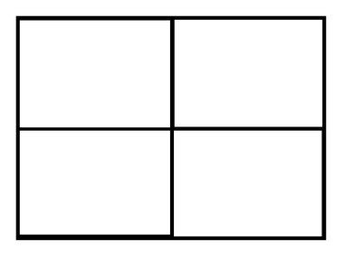
Slide 27
WHITE
PRIVILEGE
RACISM
ASSIGNED & INTERNALIZED
INFERIORITY
ASSIGNED &
INTERNALIZED
SUPERIORITY

Slide 28
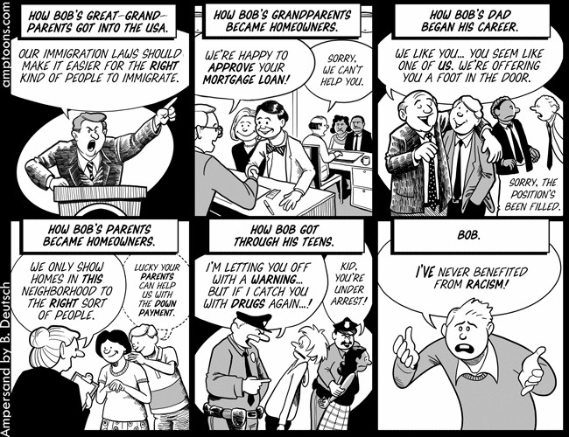
Slide 28
Notes:
White privilege and internalized white superiority are also personal, institutional, and cultural. So, for example, we tell ourselves stories about how we are not personally racist and therefore do not benefit from racism while benefitting materially (institutional access) and psychically (regular validation) as a result of belonging to the white group.

Slide 29
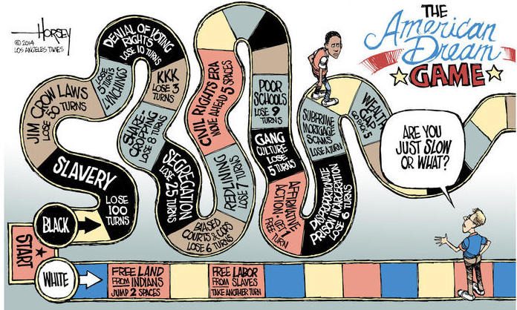
Slide 29
Notes:
This process of benefitting while creating narratives that we do not benefit works to render invisible to many of us how racism operates, which reinforces it yet again.

Slide 30
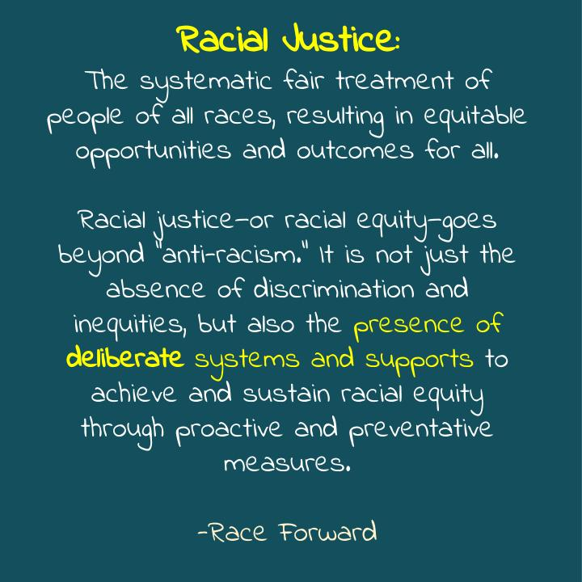
Slide 30

Slide 31
Slide 31
This is one lens for understanding oppression…
As more than personal …
As also institutional and cultural

Slide 32

Slide 32
This same lens can be used to think about how to achieve equity.
Starting with the personal …
And moving to the institutional and the cultural.

Slide 33
Slide 33
CIRCLE OF INFLUENCE
CIRCLE OF CONCERN
Based on the work of
Steven Covey and Viktor Frankl

Slide 34
Slide 34
CIRCLE OF INFLUENCE
CIRCLE OF CONCERN

Slide 35
Slide 35
PEOPLE YOU KNOW WHO CARE
PEOPLE WHO DON’T YET CARE OR YOU DON’T YET KNOW

Slide 36
Slide 36
PEOPLE YOU KNOW WHO CARE
PEOPLE WHO DON’T YET CARE OR YOU DON’T YET KNOW
AN ORGANIZING APPROACH

Slide 37
Slide 37
FIGHT FOR A FAIR ECONOMY
DELEGITMIZE RACIST INSTITUTIONS
SHIFT CULTURE / UNDERMINE WHITE SUPREMACY
Notes:
SURJ has developed a three pronged approach to change:
Delegitimize racist institutions
Fight for a fair economy that refuses to pit communities against each other
Shift culture (meaning the underlying beliefs folks have about people and the world) in a way that undermines support for white supremacy

Slide 38
Slide 38
FIGHT FOR A FAIR ECONOMY
CALL PEOPLE IN
OPEN-HEARTED
DELEGITMIZE RACIST INSTITUTIONS
SHIFT CULTURE / UNDERMINE WHITE SUPREMACY
MUTUAL
INTEREST
Notes:
SURJ believes that we must understand how white supremacy is integral to economic injustice, patriarchy and other forms of oppression. Racism and white supremacy keep the many divided for the benefit of the few. Our work, then, is to create an inclusive, open-hearted approach to organizing, calling people into our mutual interest in a racially equitable and just world.

Slide 39

Slide 39
http://www.showingupforracialjustice.org/
Join a chapter. Check list on website.
If you don’t have a chapter, start a chapter. New chapter orientations are every Thursday at 6 and it's a great first place to start.
If you aren’t up for starting a chapter, host a house party. We can send you a toolkit.
Donate!
Notes:
If you're not part of a chapter, join a chapter! Check the list on the website
If you're not part of a chapter, start a chapter! New chapter orientations are every thursday at 6 eST and it's a great first place to start.
If you're not up for starting a chapter, hold a house party (we can send them to the toolkit)
GIVE

Slide 40
Slide 40
Now take 5 minutes to talk with each other.
What does this evening’s session mean for you in terms of your next step?

Slide 41

Slide 41
All of us are impacted by white supremacy culture.
The goal is to hate our conditioning into white supremacy, not ourselves or each other.
Intent is not the same as impact. We can have good intent and still have harmful impact.
We will make mistakes, we are not a mistake.
Aspiring to be the exceptional “good” white person separates us from each other. This is not a competition. This is a collective practice.

Slide 42
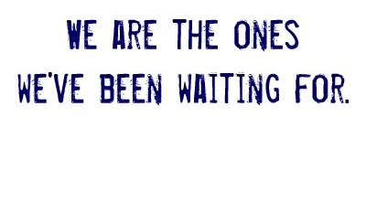
Slide 42

Slide 43
Slide 43
www.surjpoliticaledsite@weebly.com

