Slide 1
White Supremacy Culture
And what we can do about it.

Slide 2
RESOURCES
SURJ Political Ed Site - https://surjpoliticaledsite.weebly.com/white-supremacy-culture.html
Dismantling Racism Workbook – dRworksbook
http://www.dismantlingracism.org/

Slide 3
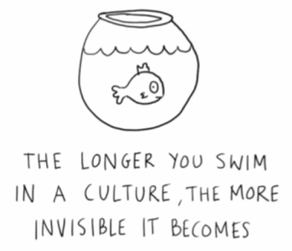
What is culture?
For the purposes of our discussion tonight, we’re going to define culture as the beliefs and values held by a group of people. Another way of thinking about culture is how a group of people define what is “normal” and what is “not normal.”

Slide 4
Introductions
Introduce yourselves, share your preferred pronouns, and share why you wanted to participate in this webinar.

Slide 5
DOMINANT CULTURE
Political
Religious
Ethnic
Racial
Class
Gender
Age
Body
Sexuality
SUBCULTURES

Slide 6
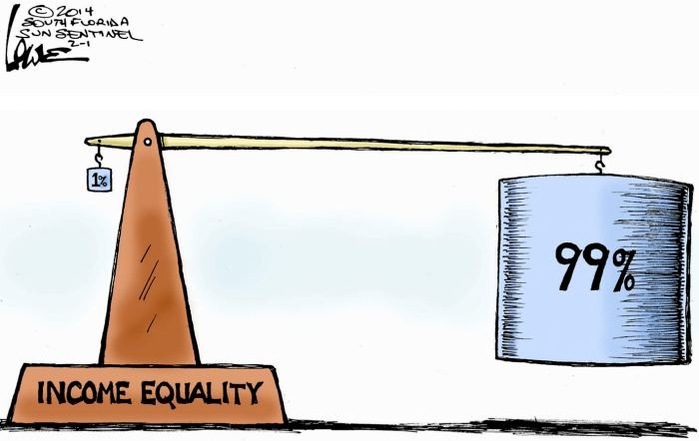
Example
In the U.S., income inequality has been steadily growing; we accept the growing gap between the rich and the rest of us as “normal,” the way things are. Can you come up with another example of a widely held cultural norm (think of one that functions to make “normal” what is actually absurd, like this example)?

Slide 7
What is cultural racism?
Cultural racism is how the dominant culture defines reality to advantage, validate, and lift up white people and disadvantage invalidate, and oppress People of Color.

Slide 8
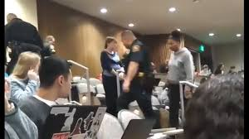
Example
Our cultural story is that POC are dangerous. Can you come up with another example of a widely held cultural norm that perpetuates racism?

Slide 9
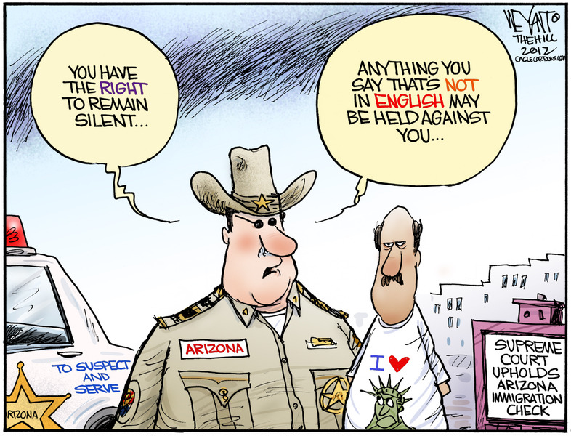
A major purpose of cultural racism is to justify racist policies and procedures.

Slide 10
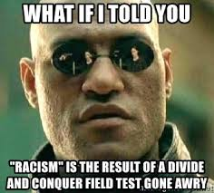
Another purpose of cultural racism is to divide white people from POC, POC from other POC, white people from other white people, and all of us from ourselves.

Slide 11
What is white supremacy culture?
White supremacy culture is one that supports the idea that white people and the ideas, thoughts, beliefs, and actions of white people are superior to People of Color and their ideas, thoughts, beliefs, and actions. This idea (or ideology) is the glue that binds together institutional policies and practices to create a national and global white supremacy system.

Slide 12
We all live in a white supremacy culture and it impacts all of us.

Slide 13
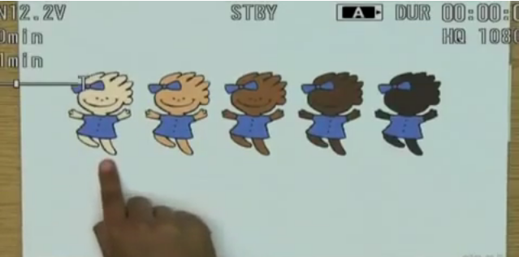
The purpose of white supremacy culture is to keep racism going. If we live in a culture that teaches us continually that white is better, then we all internalize that belief. Even as we claim we are not racist, we have been conditioned into the racist belief that white is better, which is the source of what many call implicit bias. This conditioning is so strong that children as young as the age of 3 understand that white is better and Black and Brown are at the bottom of the racial hierarchy.

Slide 14
A partial list of white supremacy characteristics includes …
Perfectionism
Either/or thinking
Right to comfort
A sense of urgency
Defensiveness/denial
Quantity over quality
Worship of the written word
Belief in only one right way
Paternalism
Power hoarding
Fear of open conflict
Individualism
Belief that I’m the only one (who can do this right)
Belief that progress is more, bigger
Belief in objectivity

Slide 15
Before we even describe them, pick one and talk about how you think it keeps racism going.
Perfectionism
Either/or thinking
Right to comfort
A sense of urgency
Defensiveness/denial
Quantity over quality
Worship of the written word
Belief in only one right way
Paternalism
Power hoarding
Fear of open conflict
Individualism
Belief that I’m the only one (who can do this right)
Belief that progress is more, bigger
Belief in objectivity

Slide 16
We’re going to focus on three: defensiveness, either/or thinking, and right to comfort.

Slide 17
Defensiveness and denial show up as
Setting up structures to protect power rather than creativity
Denying the reality or experience of others
Resisting new ideas
Taking calls for change as criticism of our leadership
Defending against or denying any naming of racism; blaming those who name racism rather than looking at the racism being named

Slide 18
Which of these have you witnessed or participated in? What are some antidotes to perfectionism?
Setting up structures to protect power rather than creativity
Denying the reality or experience of others
Resisting new ideas
Taking calls for change as criticism of our leadership
Defending against or denying any naming of racism; blaming those who name racism rather than looking at the racism being named

Slide 19
Antidotes or alternate ways of showing up:
Understand that structure should support creativity and learning
Understand and make transparent the link between defensiveness and fear (of losing power, face, comfort, privilege)
Work on your own defensiveness; dig into what you are defending against
Name defensiveness as a problem when it is one
Give people credit for handling more than you think they can
Talk about the ways defensiveness gets in the way of creativity
Support yourself and others to avoid taking things personally

Slide 20
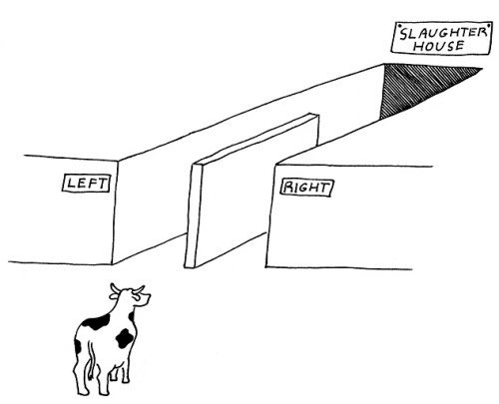
Either/or thinking shows up as
Good/bad, right/wrong, with us/against us
Closely linked to perfectionism
Inability to consider both/and or nuance
Trying to make complex things simple
Conflict and increased sense of (imposed) urgency
Misuse of power by those with an agenda who think they are ‘right’

Slide 21
Name a time you participated in either/or thinking. What were the consequences? What are some antidotes to either/or thinking?
Good/bad, right/wrong, with us/against us
Closely linked to perfectionism
Inability to consider both/and or nuance
Trying to make complex things simple
Conflict and increased sense of (imposed) urgency
Misuse of power by those with an agenda who think they are ‘right’

Slide 22
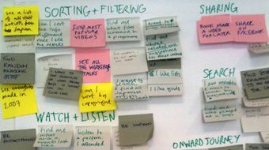
Some antidotes to either/or thinking …
Notice when it shows up in our talk with each other and push for a wider range of alternatives
Notice when a sense of urgency arises and make space for moving more slowly and thoughtfully
Take a break so we can think more creatively
Avoid making decisions under extreme pressure (and plan for how to do that ahead of time)
Consider a range of options and pick one knowing that it could be the wrong one (avoid “one right way” thinking)
Remember to have a sense of humor

Slide 23
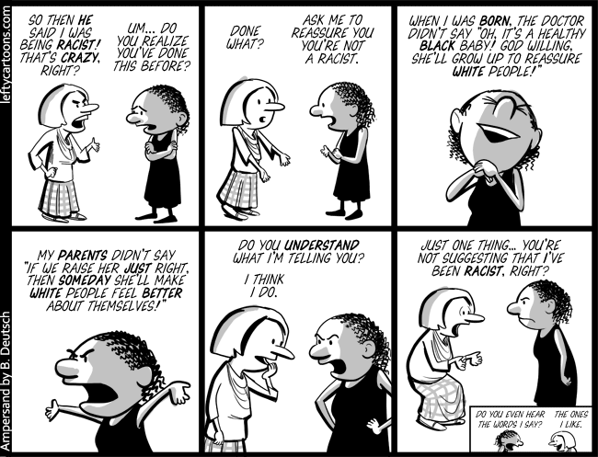
Right to comfort shows up as
Believing we have a right to emotional and psychic safety
Blaming whoever is making us uncomfortable rather than focusing on the problem being named
Equating our experience of unfairness with systemic racism
Expecting the world to be fair (for and to us)
Expecting our feelings and questions to be addressed in our time frame and on our terms so that we can feel better quickly
Expecting to be reassured when we are uncomfortable

Slide 24
How have you seen right to comfort show up? In yourself? In others? What are some antidotes to right to comfort?
Believing we have a right to emotional and psychic safety
Blaming whoever is making us uncomfortable rather than focusing on the problem being named
Equating our experience of unfairness with systemic racism
Expecting the world to be fair (for and to us)
Expecting our feelings and questions to be addressed in our time frame and on our terms so that we can feel better quickly
Expecting to be reassured when we are uncomfortable

Slide 25
Some antidotes to right to comfort are …
Understanding that discomfort is at the root of all growth and learning
Welcome it as much as we can
Talk to a trusted friend (who we know is ready and able to hold what we are feeling)
Separate our feelings from what we do with our feelings (there are no wrong feelings); focus on thoughtful action
Avoid taking things personally; remember it is not about us
Take responsibility for our feelings

Slide 26
Now pick one from the list and have a conversation about how it shows up and possible antidotes.
A sense of urgency
Perfectionism
Quantity over quality
Worship of the written word
Belief in only one right way
Paternalism
Power hoarding
Fear of open conflict
Individualism
Belief that I’m the only one (who can do this right)
Belief that progress is more, bigger
Belief in objectivity

Slide 27
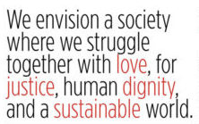
CALLING PEOPLE IN, NOT OUT
ACCOUNTABILITY THROUGH COLLECTIVE ACTION
TAKE RISKS, MAKE MISTAKES, LEARN, AND KEEP GOING
ORGANIZE OUT OF MUTUAL INTEREST
THERE IS ENOUGH FOR ALL
GROWING IS GOOD
CENTER CLASS

Slide 28
dRworks Racial Equity Principles
Know yourself.
Work on all three levels.
Think and act collectively.
Be accountable to principles and to people.
Honor and build power on the margins.
Transparency.
Set explicit goals.
Use organizing mind and focus on your circle of influence.
Take risks and learn from your mistakes.

Slide 30
RESOURCES
SURJ Political Ed Site - https://surjpoliticaledsite.weebly.com/white-supremacy-culture.html
Dismantling Racism Workbook – dRworksbook
http://www.dismantlingracism.org/

